Slide 1


Slide 2

Notes:
More time here

Slide 3
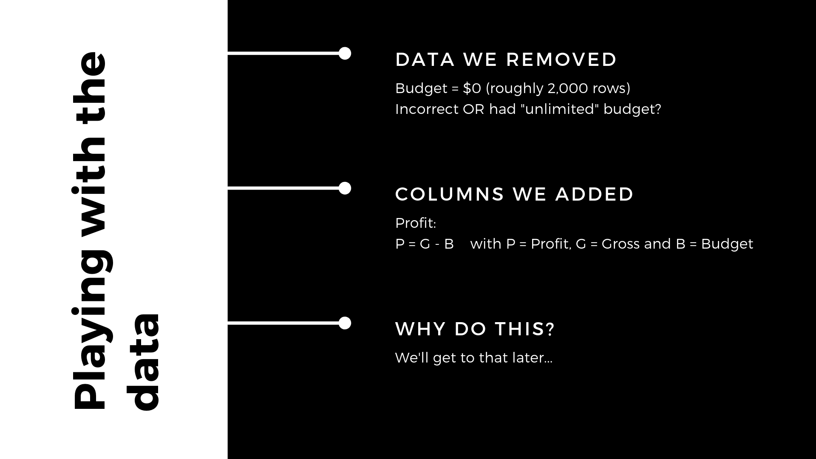
Notes:
Mention how many rows we had in the original dataset

Slide 4

Notes:
Why is the profit negative?

Slide 5
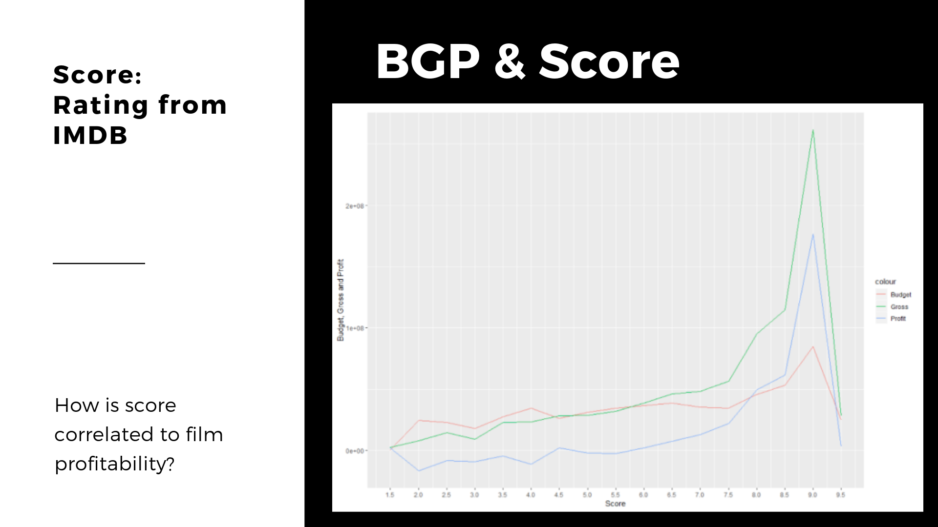
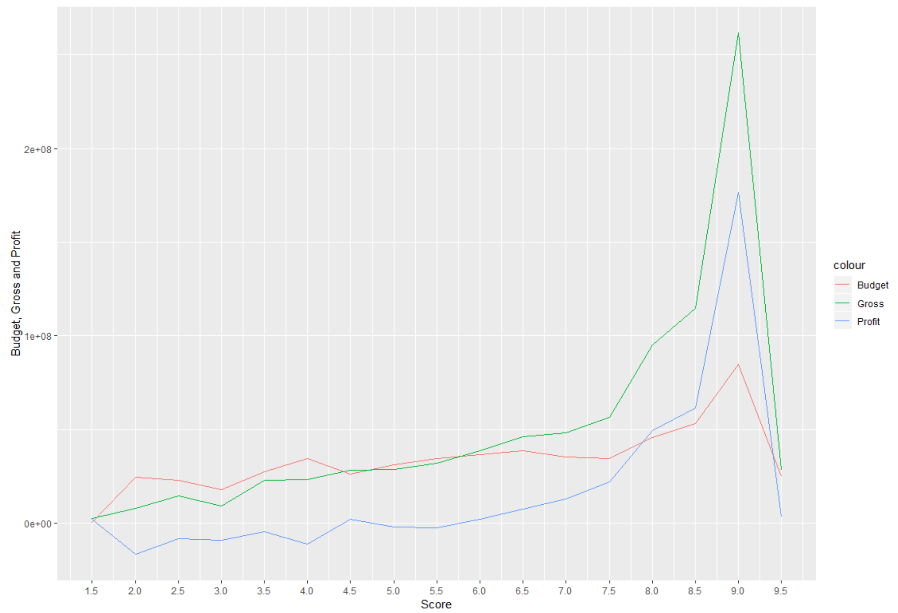
Notes:
As the Profit, Budget and Gross increases, the imdb score also increase.
As we can see at score 9 we have a highest increase in the graph we have the most successful movies at that range..
Y dropped?
As the score range is between 1.5 and 9.5 . There is only 1 observation for 9.5, which is why there is sharp drop at 9.5.

Slide 6
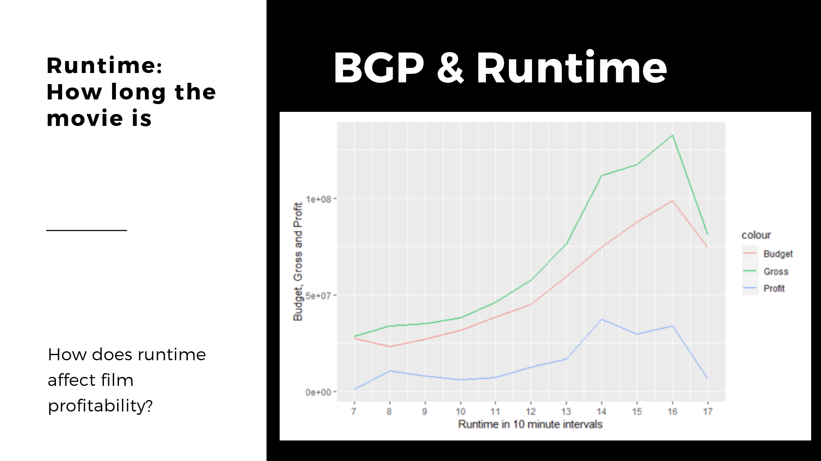
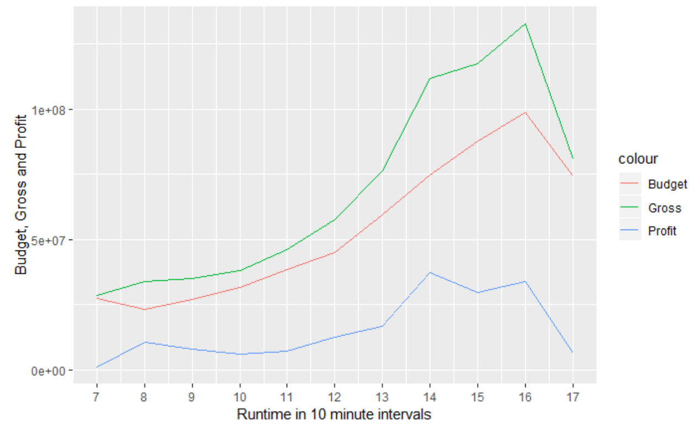
Notes:
We can observe the same pattern as in the last slide. As the runtime goes up, the budget, gross and profit also go up.
The same pattern as in last slide emerges where you can see a sharp drop at the very long end.

Slide 7
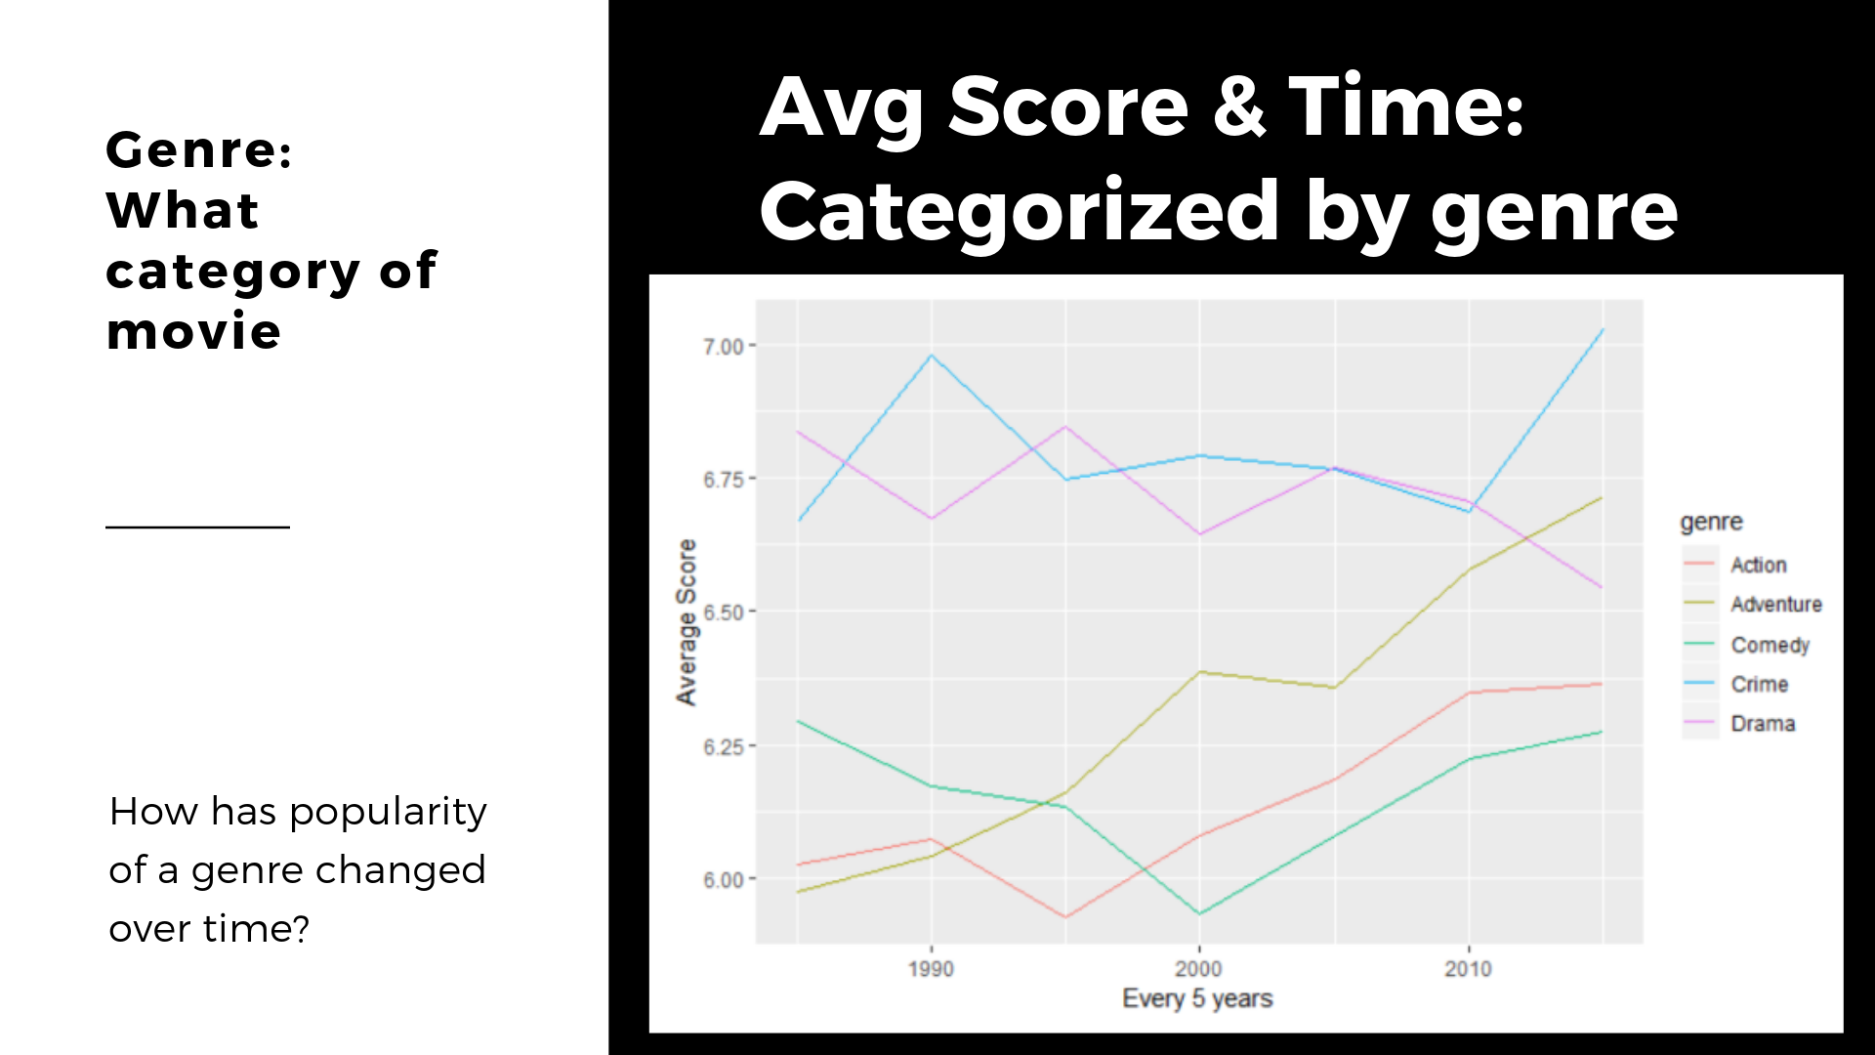
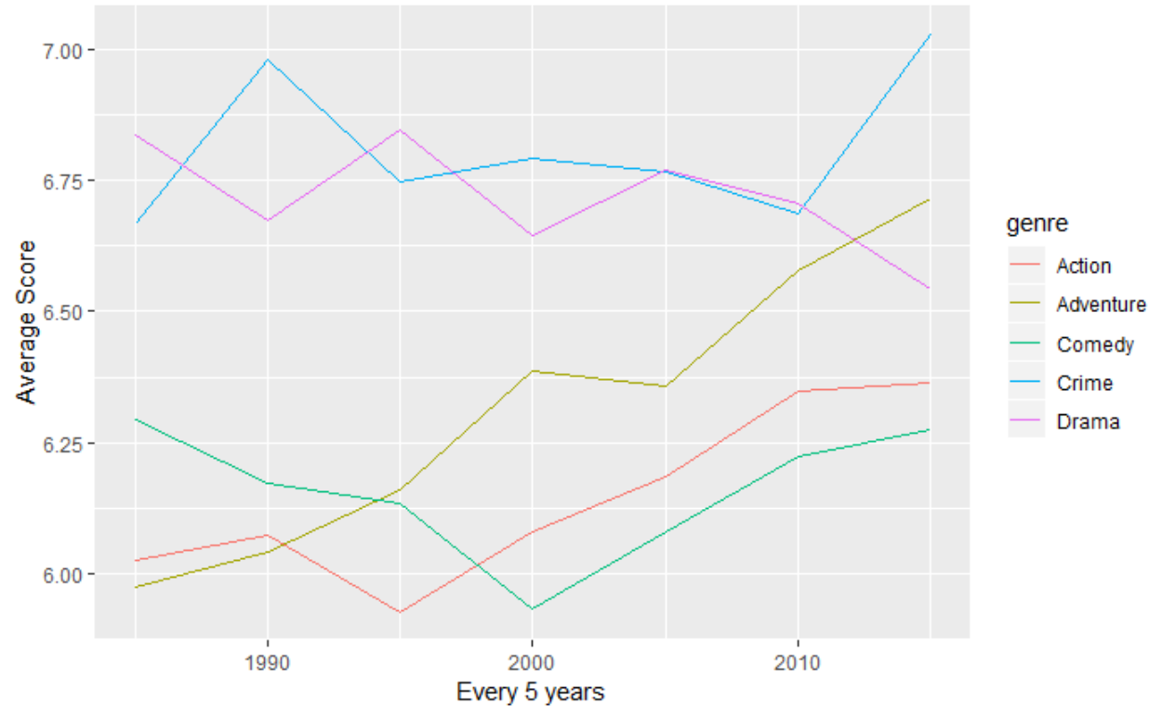
Notes:
As we had summarize the year into 5 years we can observe that the drama and crime movies have the highest score as compared to other genre.
The Adventure, Action and Crime is increasing over time. We can see that Crime and Drama movies generally score much higher and also seem to have more stable ratings.
Why did we aggregate/summarize the data: data looks like stock Market, fluctuates heavily

Slide 8
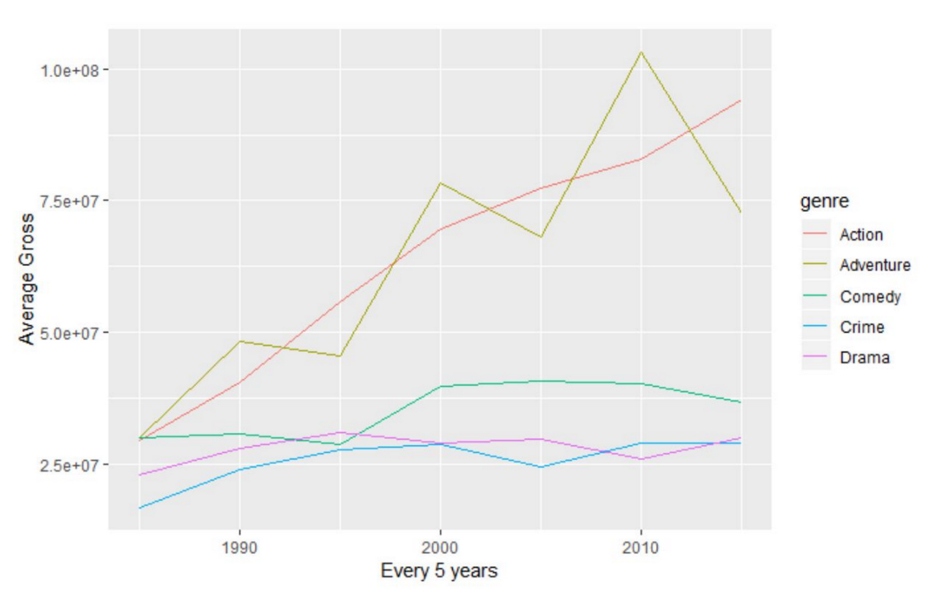
Gross
Notes:
The adventure and action movies have the highest growth in gross over time as compared to the other genre.
The Comedy, Drama and Crime movies have almost constant gross.

Slide 9


Slide 10


Slide 11

Notes:
thought to include AA, until we realized that most movies have never won one - there is also something a bit problematic leaving the determination of success in the hands of a group of very small people….

Slide 12
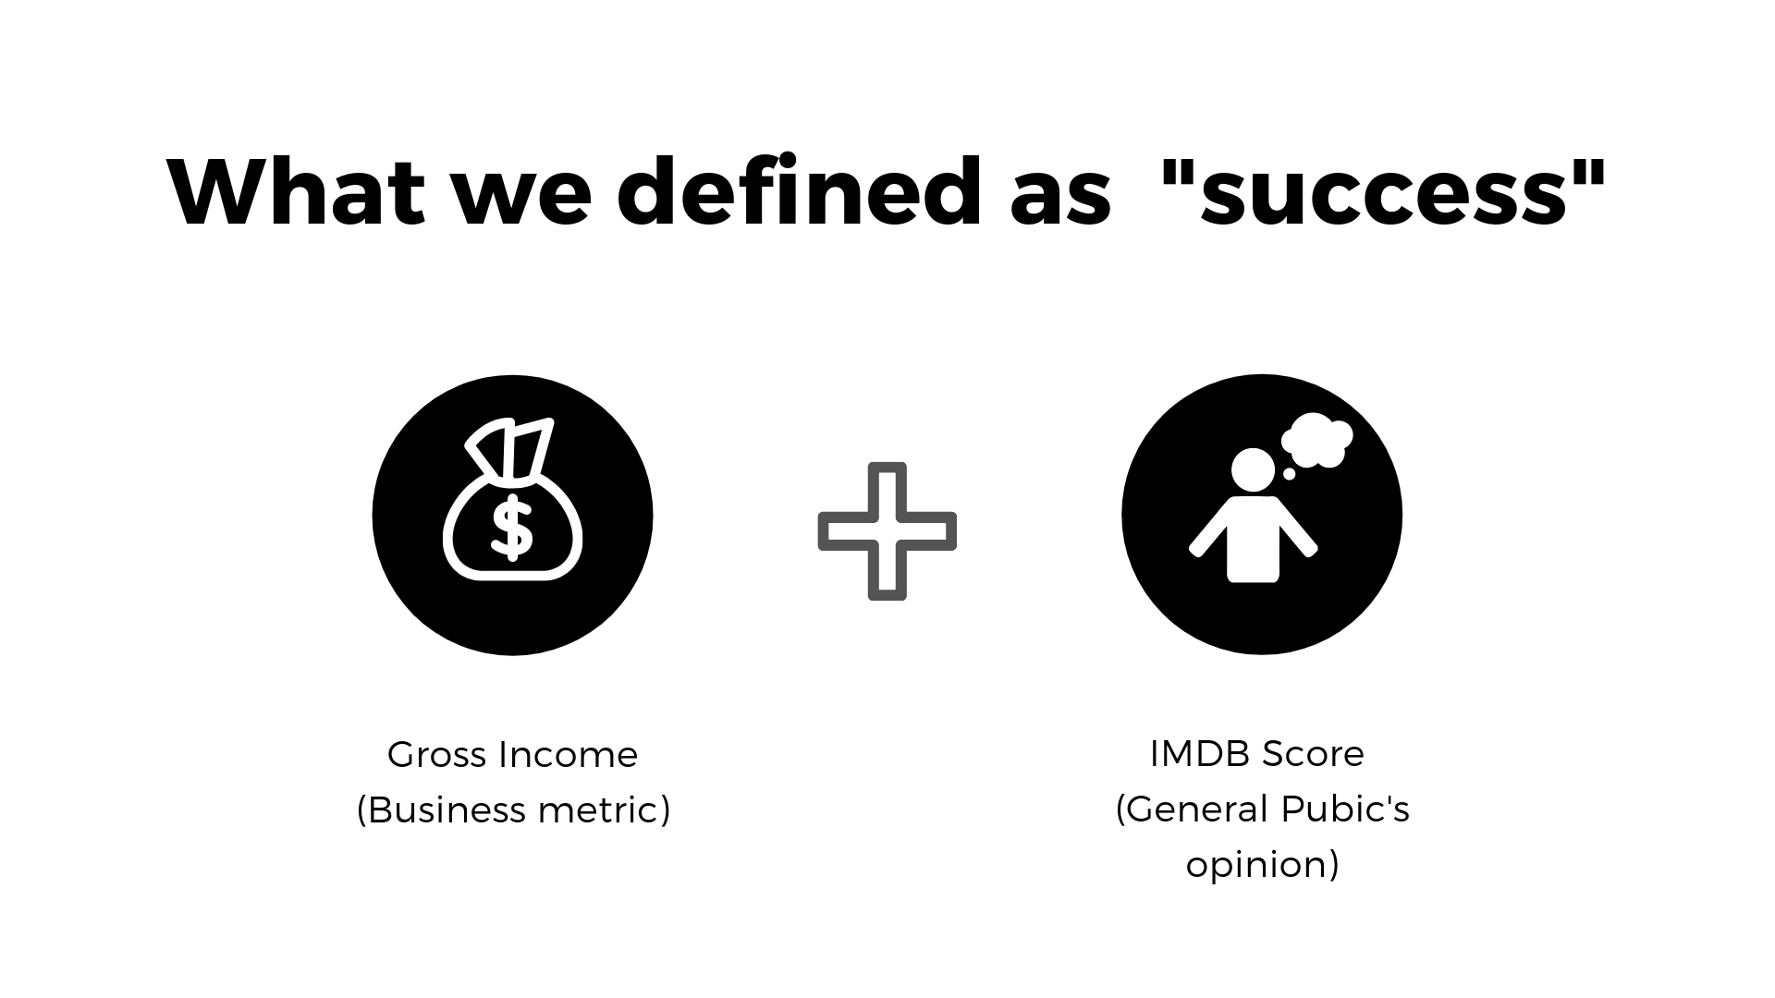
Notes:
Business +general likability

Slide 13

Notes:
Our variables that defined success need to be transformed to be weighted equally - so that one variable did not become the main influence of success

Slide 14

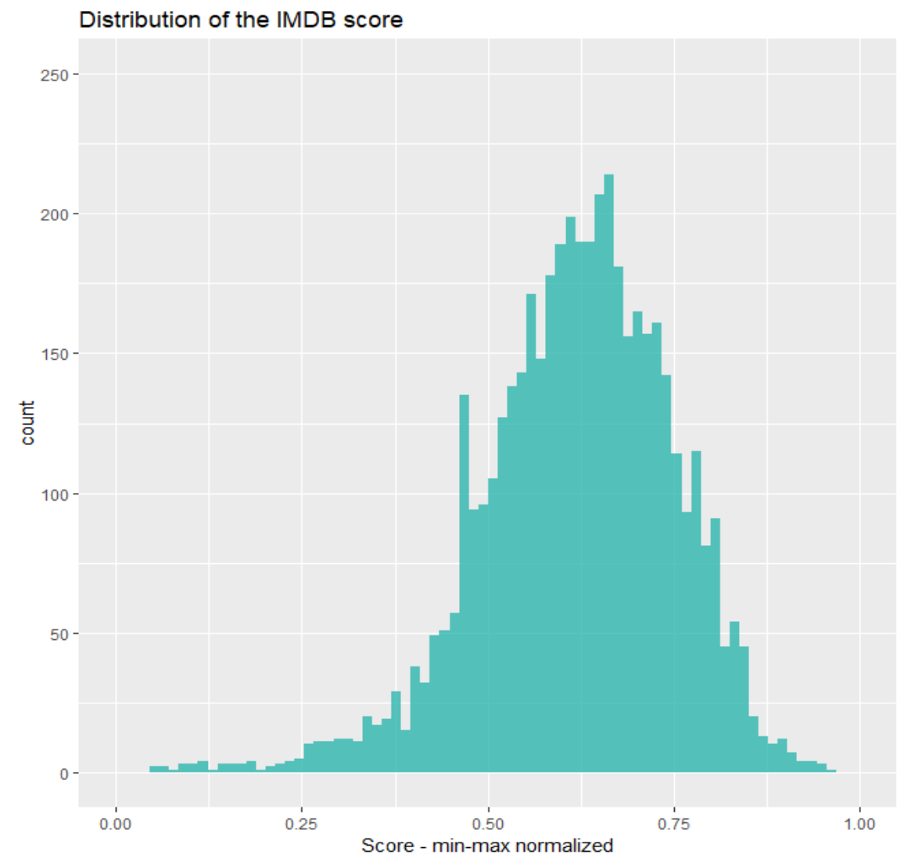

Slide 15

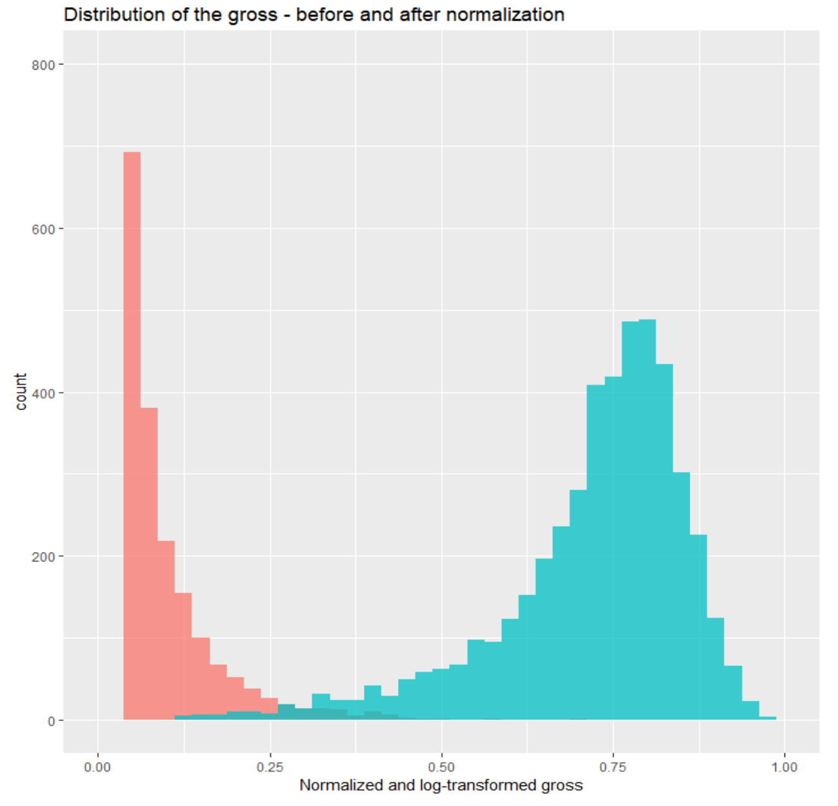
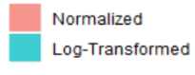

Slide 16
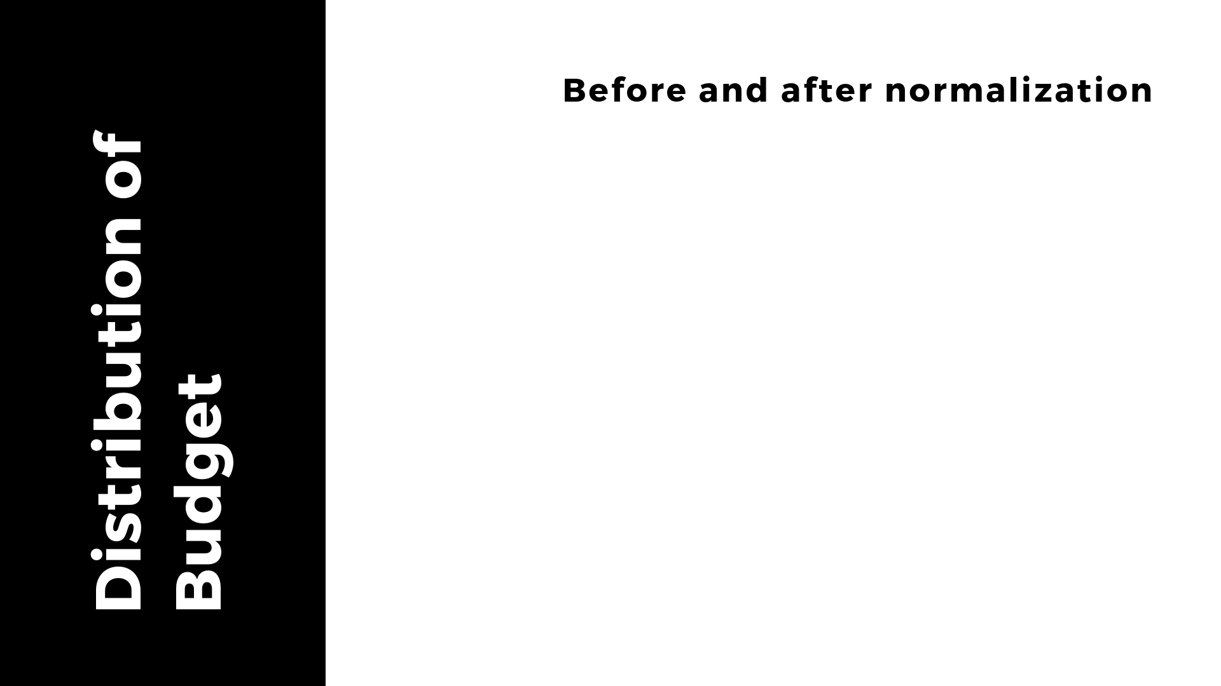
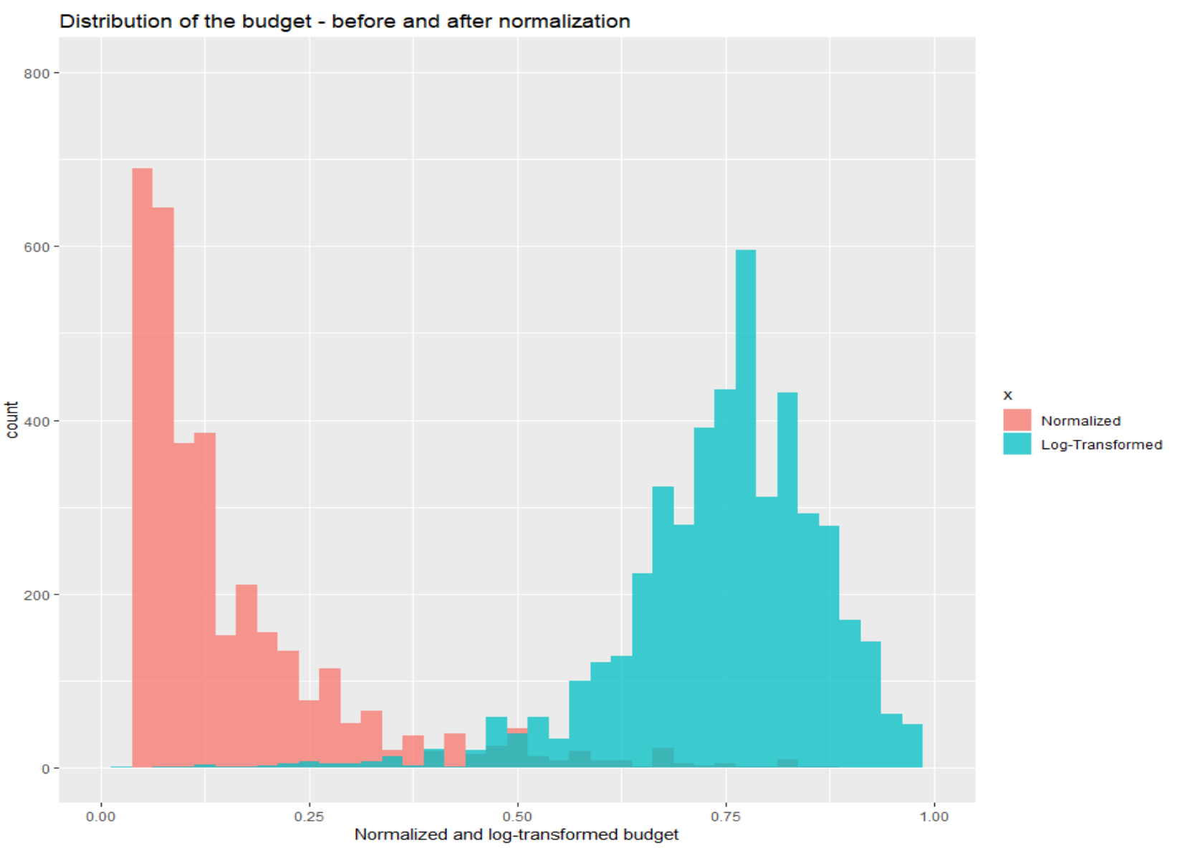
Notes:
Because this is so closely correlated to gross, we felt it would make sense to also normalize budget
Slide that shows the creation of the budget variable

Slide 17


Slide 18
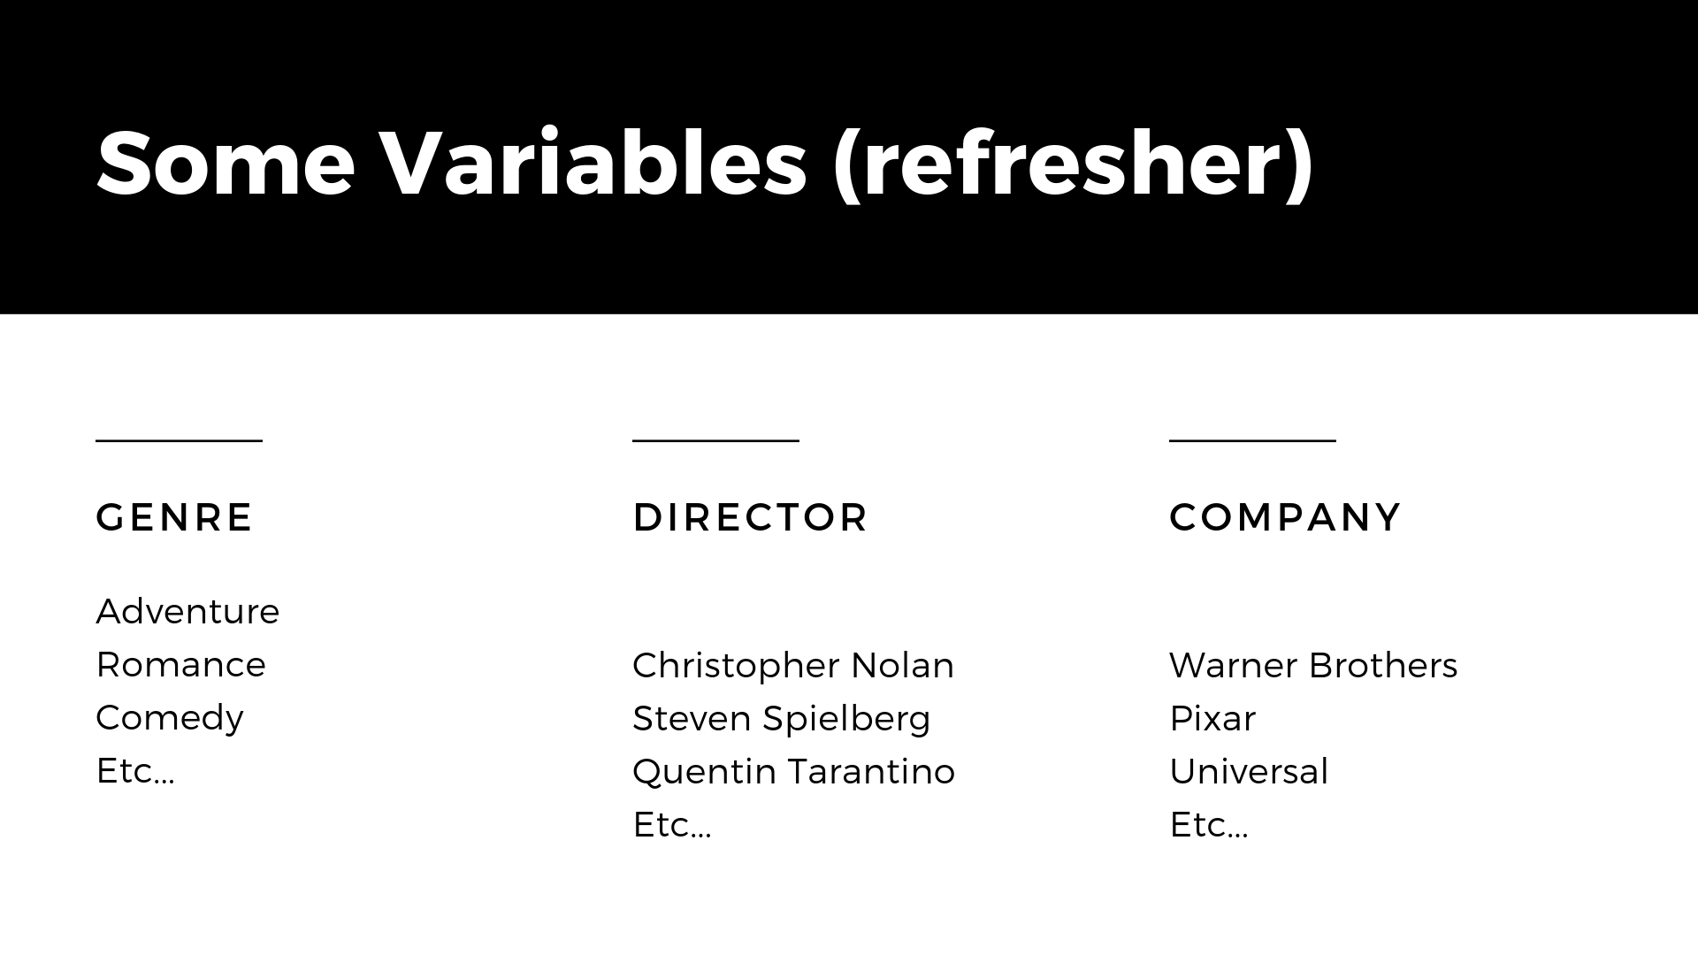

Slide 19


Slide 20

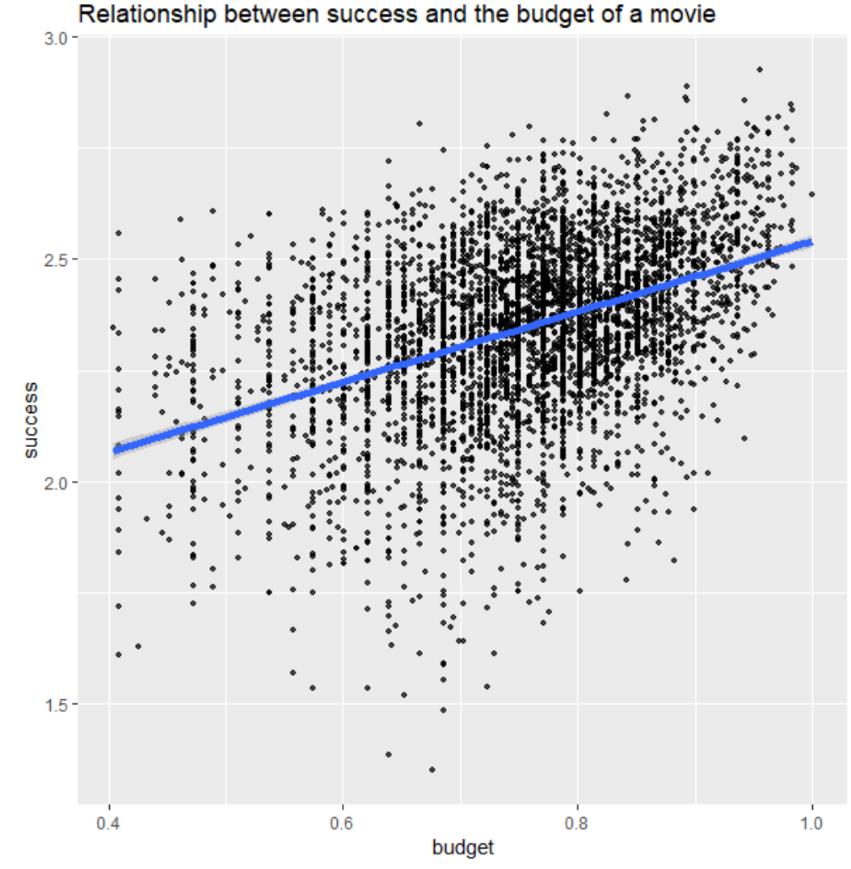

Slide 21


Slide 22
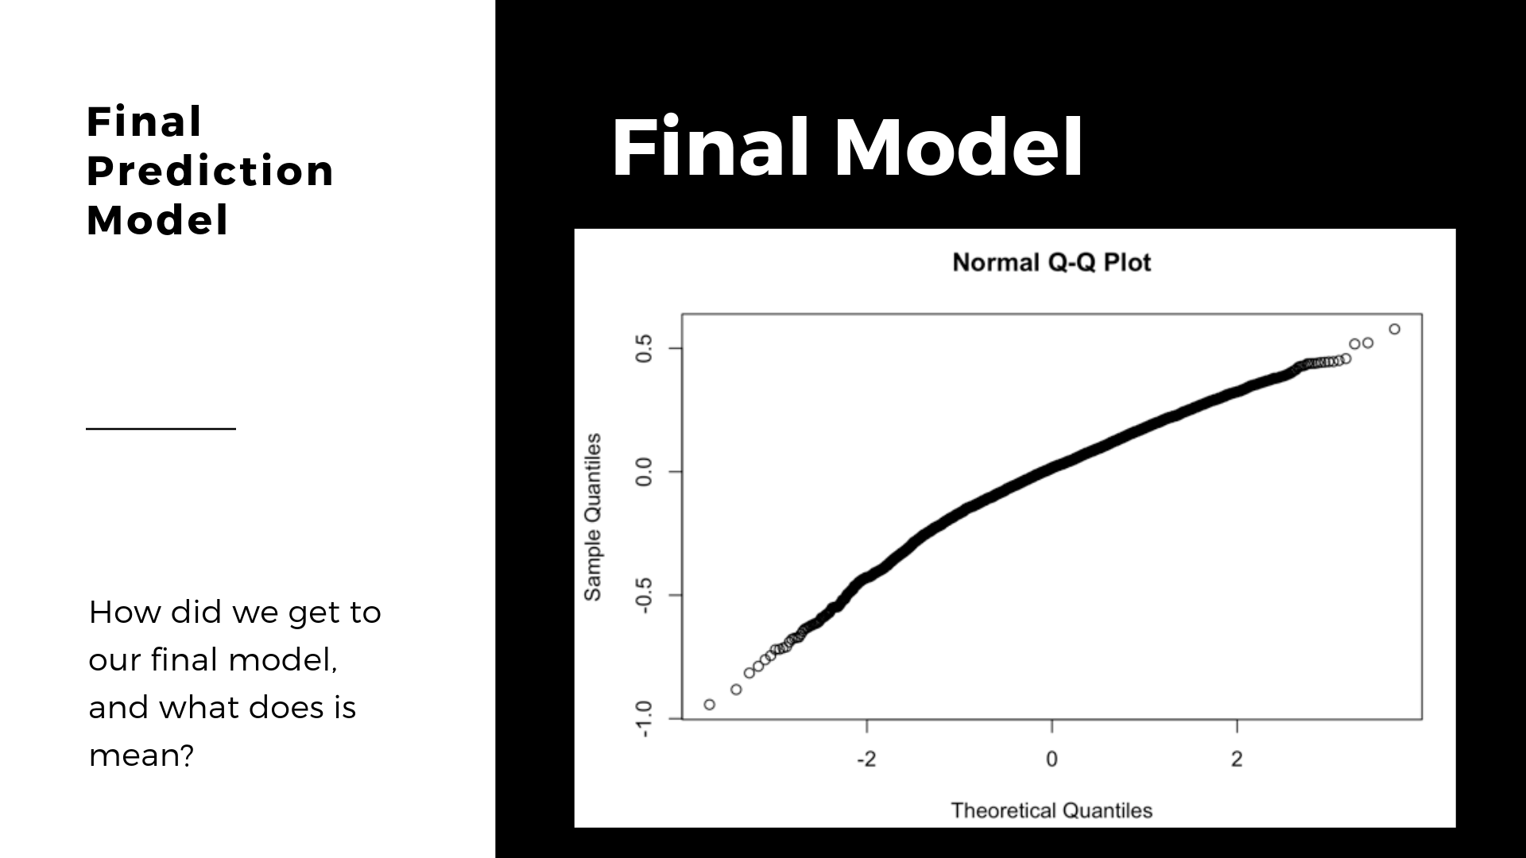
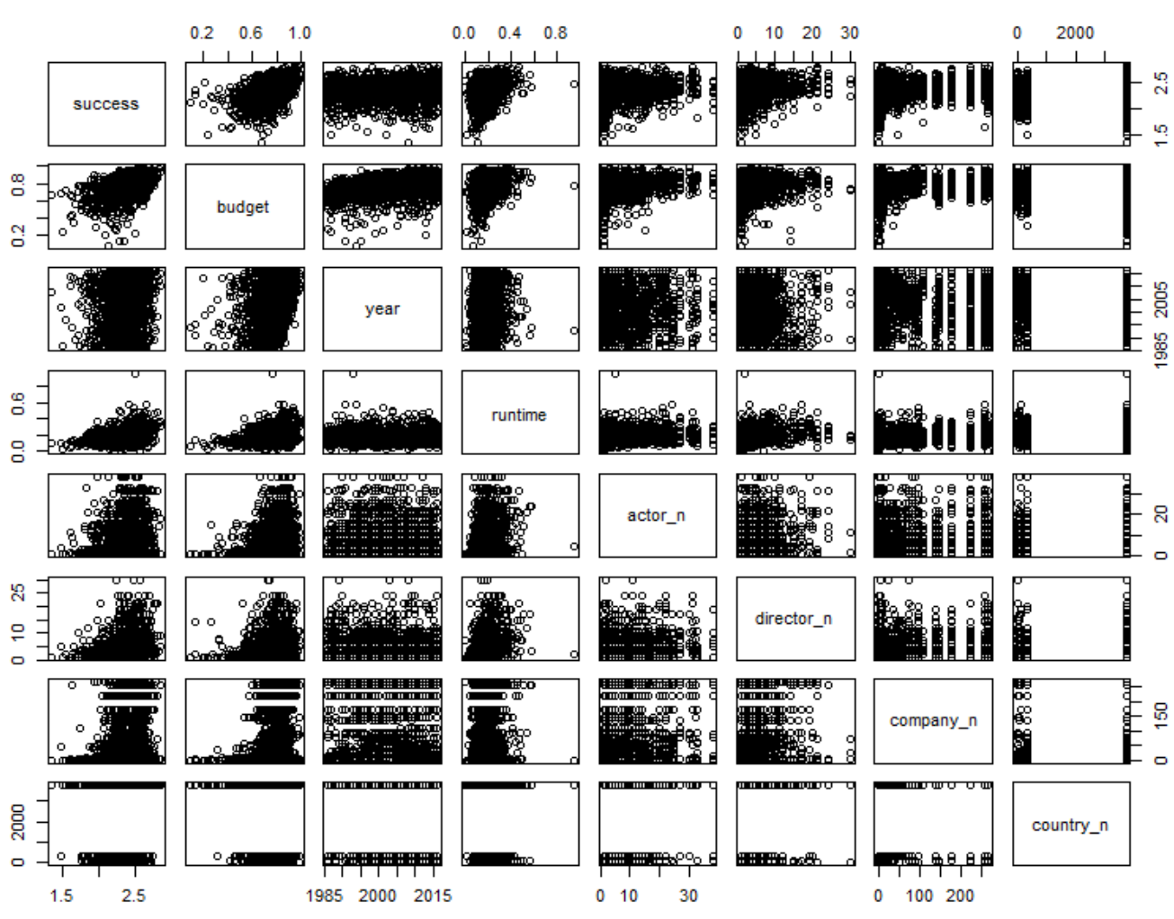

Slide 23
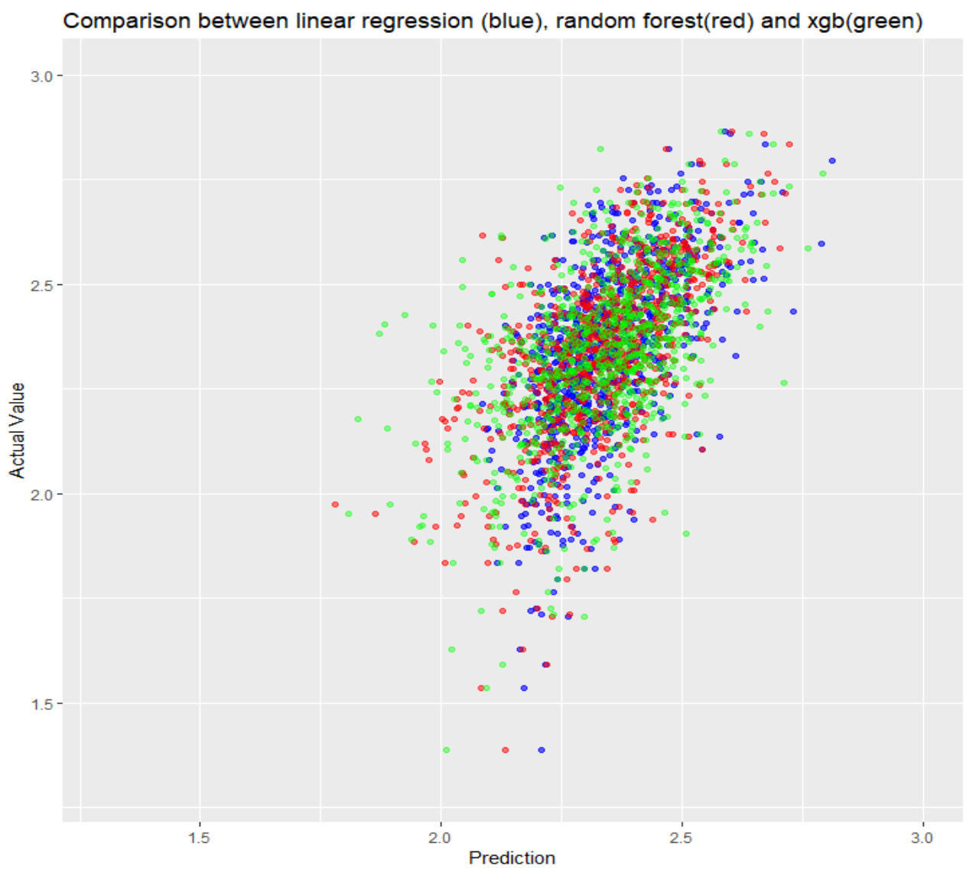

Slide 24
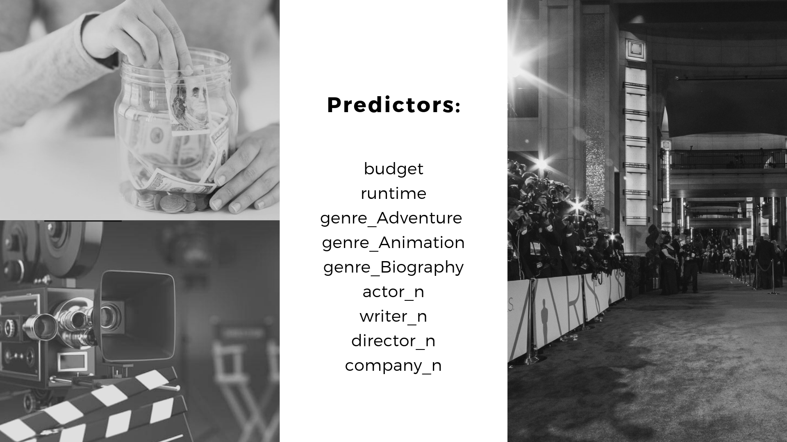
Notes:
(Intercept) 1.9031675 0.0195705 97.247 < 2e-16 ***
budget 0.3304721 0.0277361 11.915 < 2e-16 ***
runtime 0.7504249 0.0368405 20.370 < 2e-16 ***
genre_Adventure 0.0268354 0.0119907 2.238 0.0253 *
genre_Animation 0.1904120 0.0135358 14.067 < 2e-16 ***
genre_Biography 0.0540178 0.0124633 4.334 1.5e-05 ***
rating_r -0.0113667 0.0060284 -1.886 0.0594 .
actor_n 0.0029679 0.0003566 8.323 < 2e-16 ***
writer_n 0.0074220 0.0008741 8.491 < 2e-16 ***

Slide 25
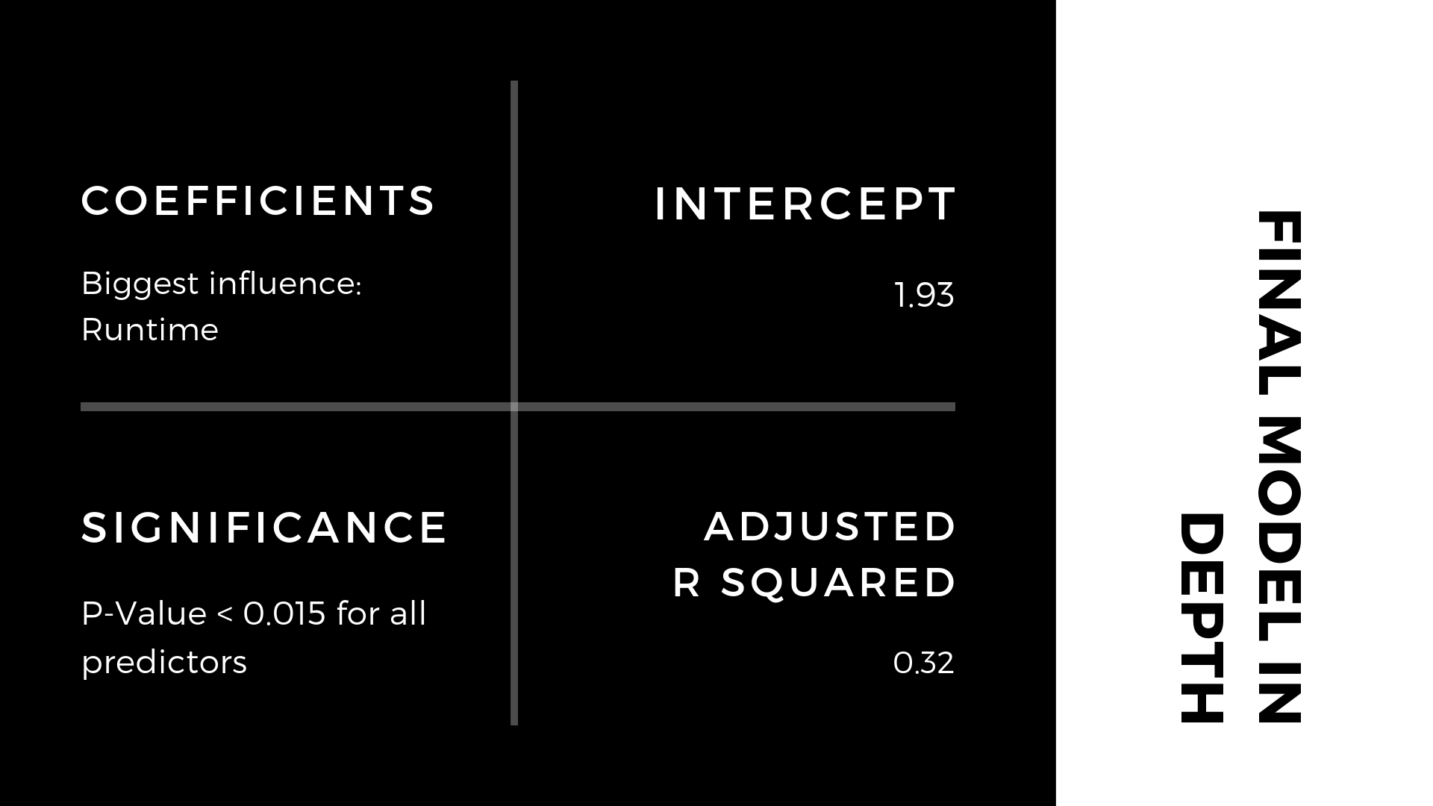
Notes:
Intercept of 1.9
Coefficients:
Biggest influence: Runtime & Budget
-> values not interpretable due to log transformation
R-Rated movies have a small negative influence on success
Significance: P-Value < 0.01 for all predictors
Adjusted R-Squared of 0.32

Slide 26
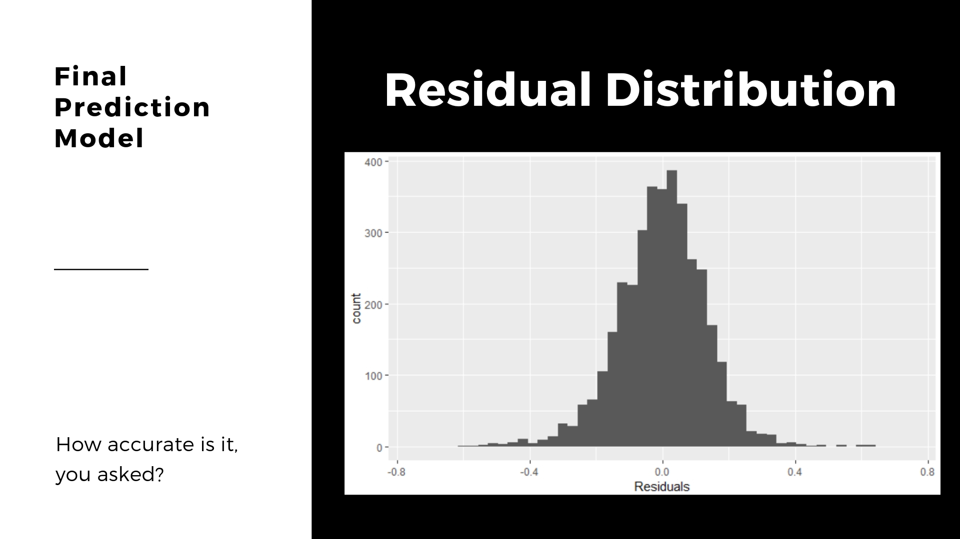
Notes:
My notes (don’t add to slides):
We also calculated some other measures:
Mean Absolute Percentage Error of 5.4%
MAE -0.4%

Slide 27
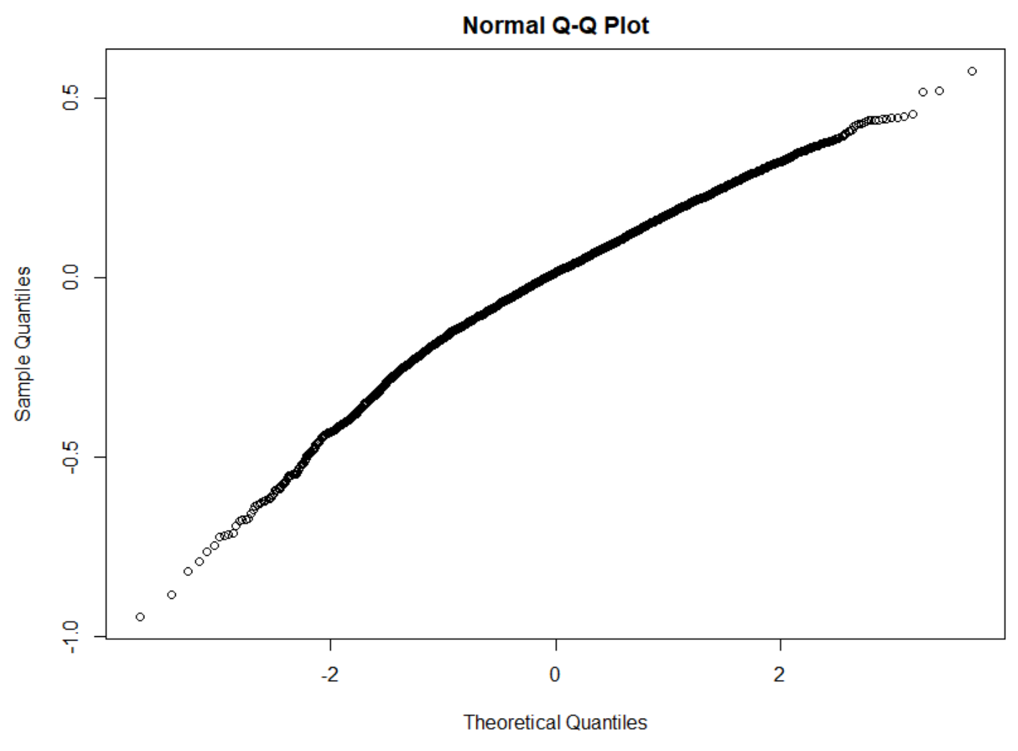
Notes:
My notes (don’t add to slides):
We also calculated some other measures:
Mean Absolute Percentage Error of 5.8%

Slide 28

Notes:
By using our model we predicted that the end game is probably going to be the most successful movie ever.
We got this value by applying our linear model
Best score for our model is 3
If is 3.1----Its depend upon the dataset as well as the linear model.

Slide 29
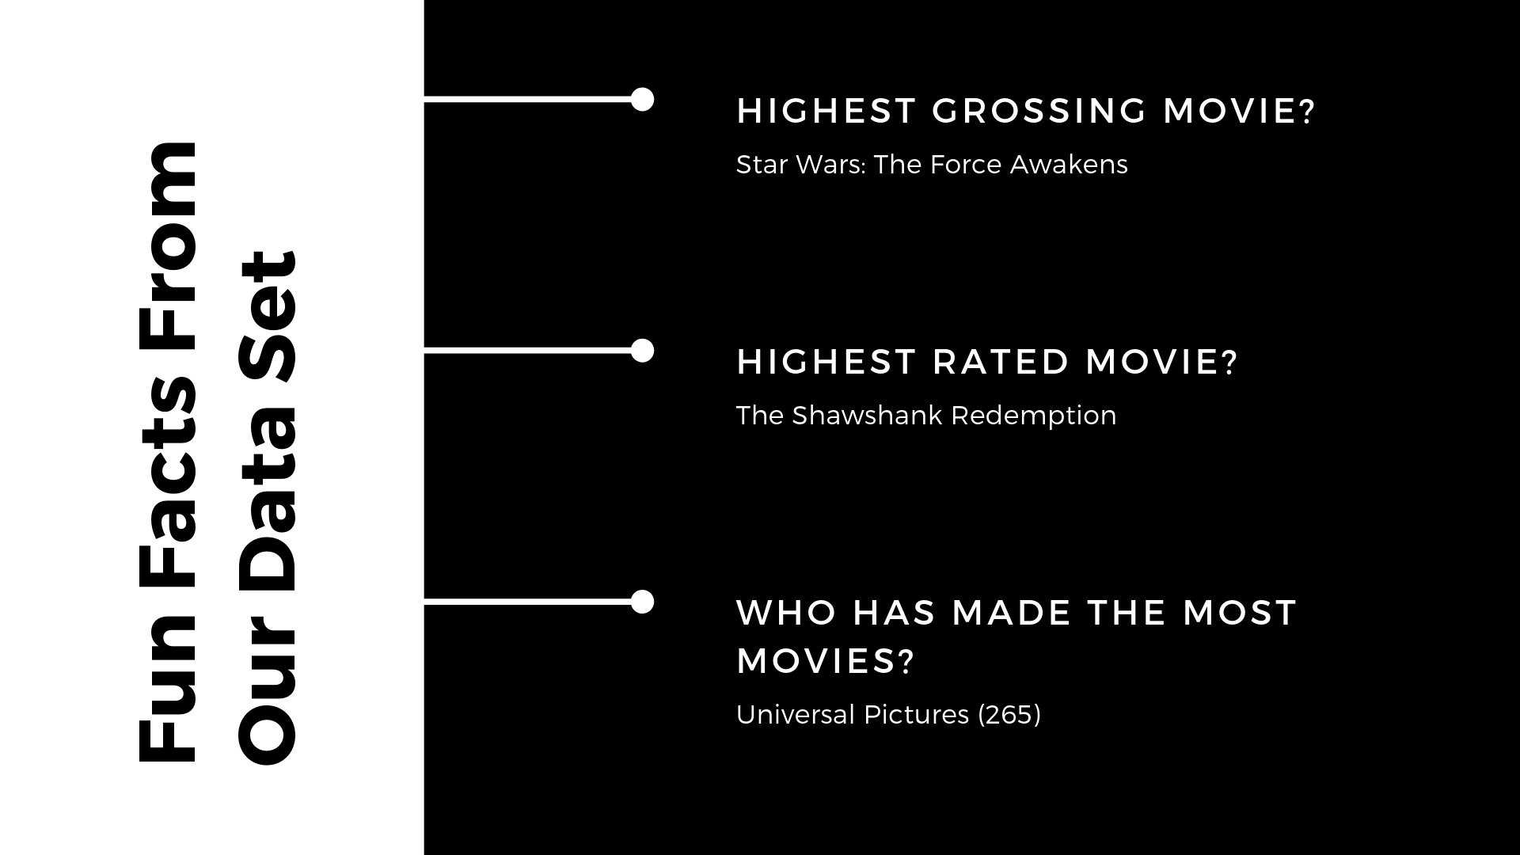
Notes:
These facts are only true for our dataset:
Looking at our dataset, which does not contain all movies, we have found these fun facts to be true. The highest grossing is NOT adjusted for inflation. Actually, Gone with the wind (1939) is the highest grossing of all time

Slide 30


Slide 31
